Slide 1



Hotel Booking Analysis: Cancellation Patterns
This analysis examines hotel booking cancellation patterns and their impact on revenue. We'll explore factors affecting cancellations and provide recommendations to reduce them.
by Abdelkhalek Shams

Slide 2

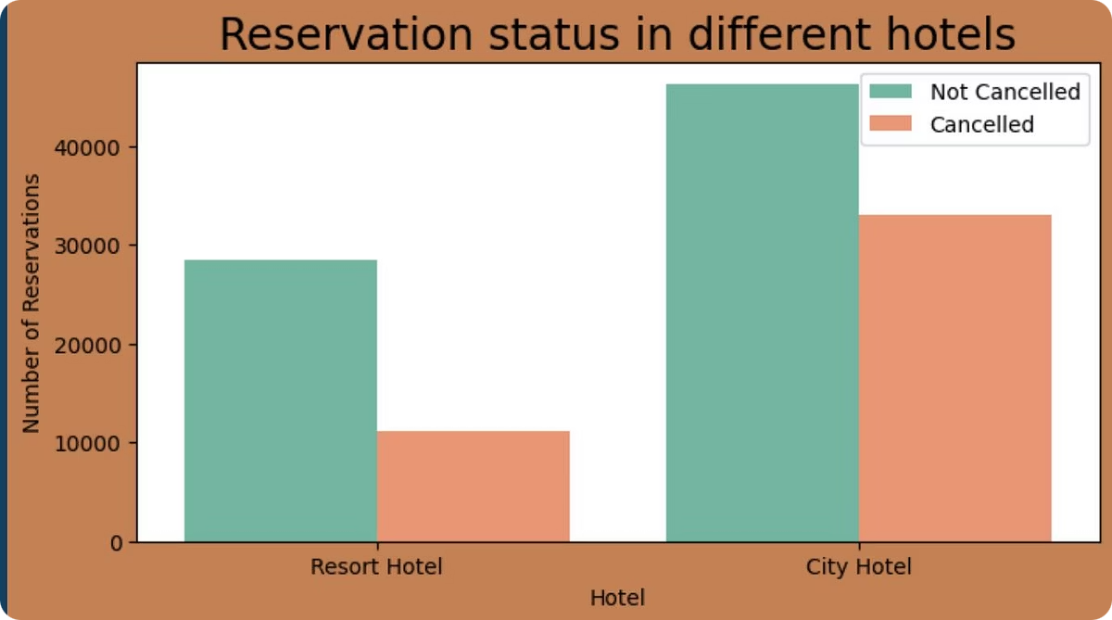
Cancellation Overview
37.1%
62.9%
Cancellation Rate
Completed Bookings
Over one-third of all hotel bookings end in cancellation.
Majority of reservations are fulfilled as planned.
↓
Revenue Impact
Cancellations significantly affect hotel revenue streams.

Slide 3
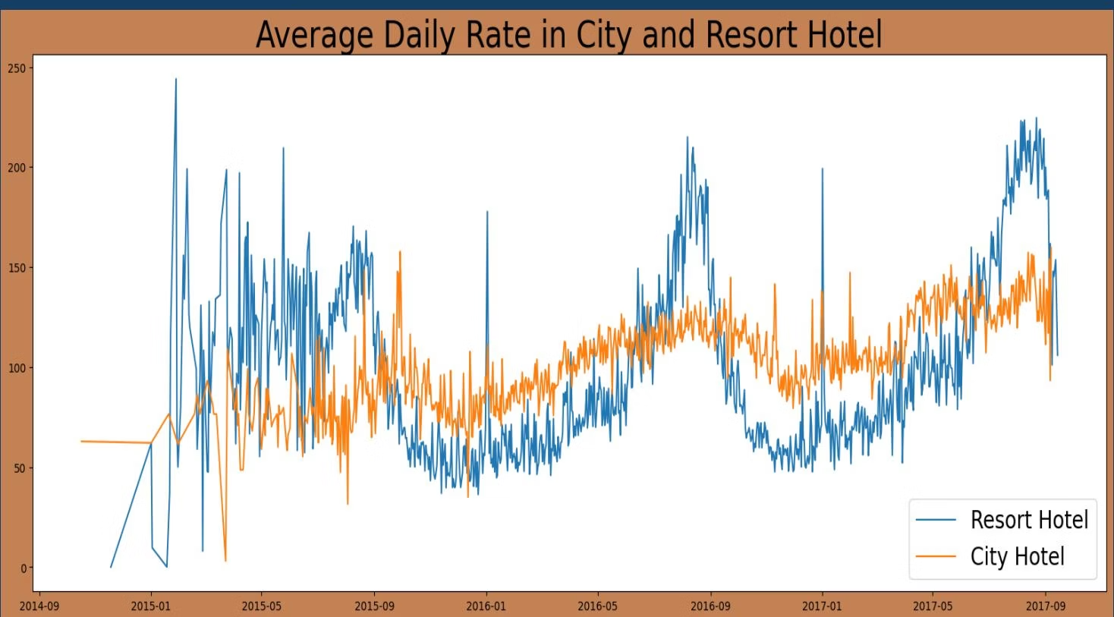
Hotel Type Comparison
City Hotels
Resort Hotels
Higher booking volume overall.
Lower booking volume overall.
Higher cancellation rates compared to resorts.
Lower cancellation rates than city hotels.
More stable pricing throughout the year.
Significantly higher prices on average.

Slide 4

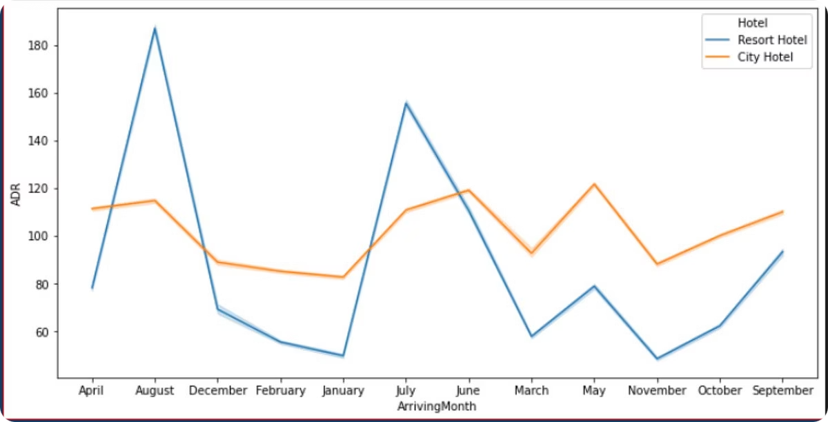
Seasonal Price Variations
1
Resort Hotels
Peak prices during July, August, and September.
Lowest rates during winter months.
2
City Hotels
Slightly higher rates during March, April, and May.
More consistent pricing year-round.
3
Weekend Effect
Resort prices rise significantly during weekends and holidays.

Slide 5
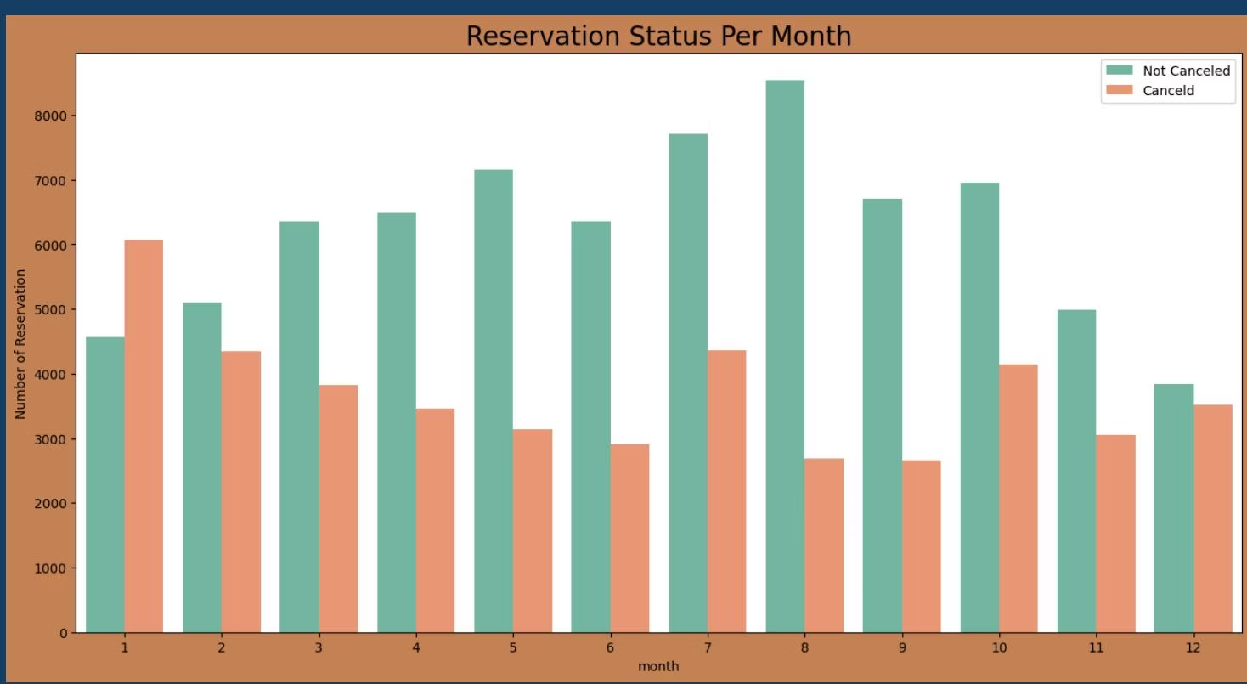
Monthly Booking Patterns

Slide 6

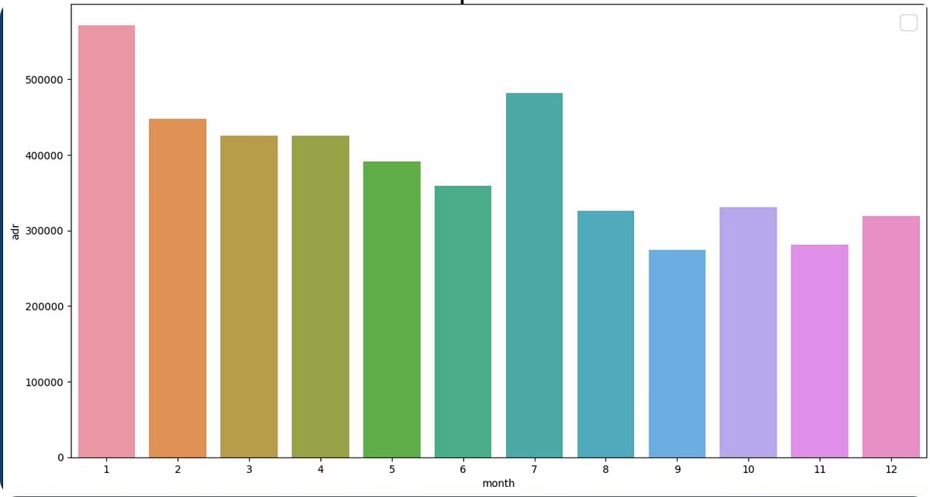



Price Impact on Cancellations
Higher Prices
Lead to increased cancellation rates.
Price Sensitivity
Primary factor influencing booking decisions.
Lower Prices
Result in fewer cancellations.

Slide 7
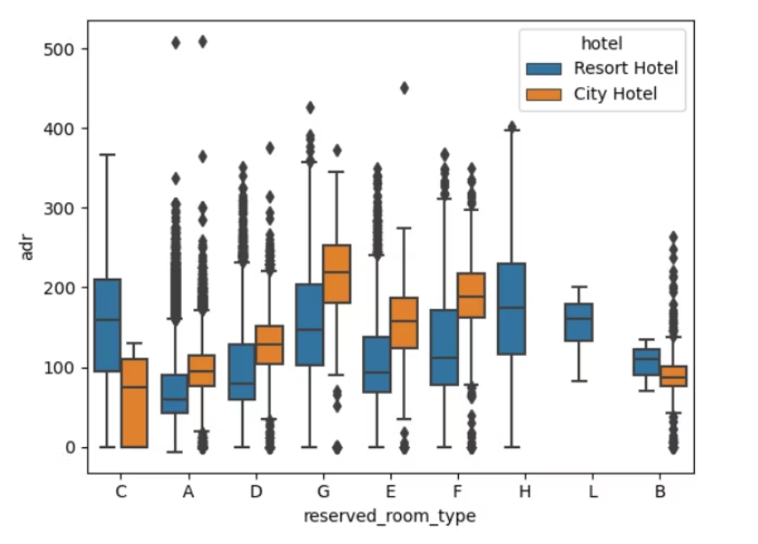
Factors Affecting Pricing
Room Types
Meal Arrangements
Seasonal Factors
Geographic Location
Different room categories command varying price points.
Meal plans significantly impact overall booking costs.
High season commands premium pricing.
Portugal has highest cancellation rates among all countries.

Slide 8

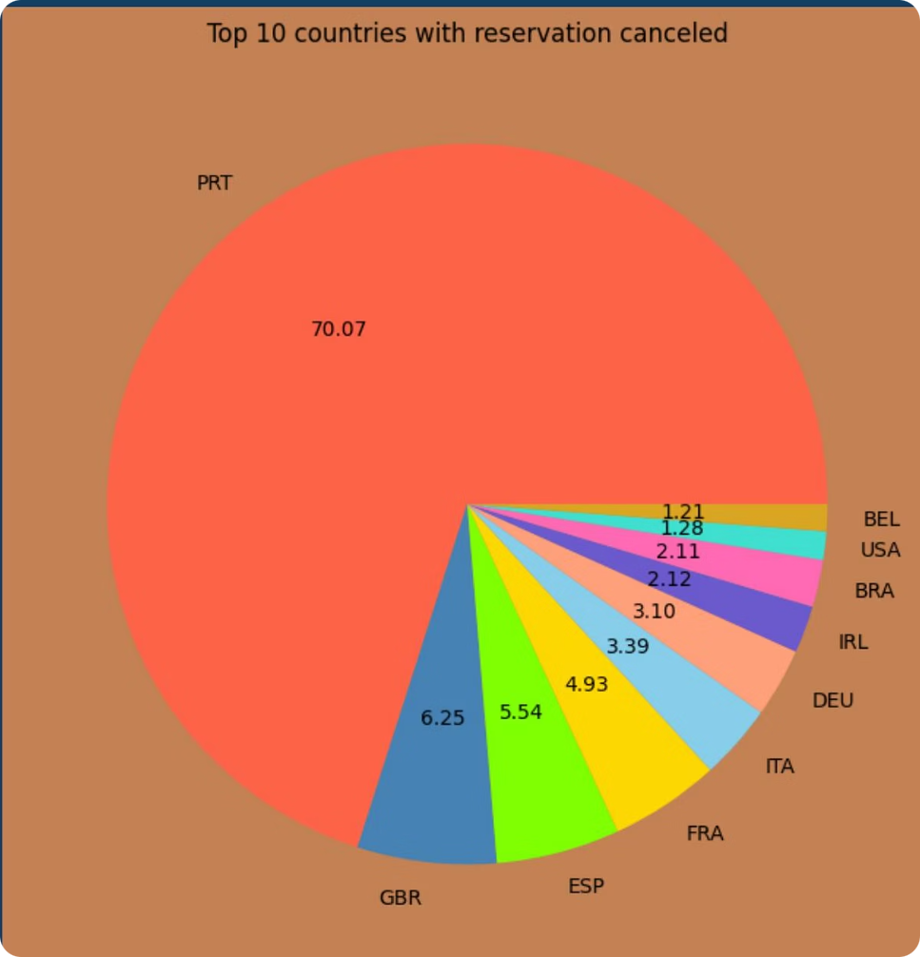
Cancellation vs. Daily Rate
Higher ADR = More Cancellations
Price Sensitivity
Customers are highly responsive to price increases.
Canceled bookings consistently show higher average daily rates.
Deposit Policies
No-deposit policies may contribute to higher cancellation rates.

Slide 9





Recommendations
Refine Pricing Strategies
Offer location-specific rates and customer discounts to reduce cancellations.
Review Deposit Policies
Consider adjusting no-deposit policies that may contribute to cancellations.
January Marketing Campaigns
Launch special offers during January to combat high cancellation rates.
Focus on Resort Model
Learn from resort hotels' lower cancellation ratios.

